Slide 1
Embedded Real-Time Operation System
About Porting Andorid on NT9263 Board

Slide 2
Abstract
Hardware Specification
The Flow of Porting
Other problems in the process
Reference

Slide 3
Abstract
Hardware Specification
The Flow of Porting
Other problems in the process
Reference

Slide 4
Abstract
In recent years, Google has started to develop a free and open source based software platform that called android. Now, as we know, android platform is very attractive on the market of commercial electronic products. In our topic, we will port android on NT9263.

Slide 5
Abstract
Hardware Specification
The Flow of Porting
Other problems in the process
Reference

Slide 6
Hardware specification
CPU：Atmel AT91SAM9263B
RAM：SDRAM:64Mbytes 32Bits Bus
SRAM :4Mbits
ROM：Parallel Nor Flash 64Mbits
Data Flash 64Mbits
NAND Flash:256MBytes
Ethernet
Audio out
800x480 LCD
VGA

Slide 7
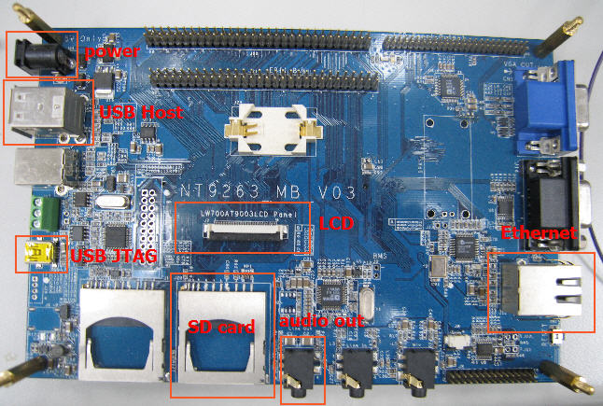
Snapshot of NT9263 Board

Slide 8
Abstract
Hardware Specification
The Flow of Porting
Other problems in the process
Reference

Slide 9
The Flow of Porting
1. Setting up The Develop Environment
Host System Setup：Linux Ubuntu 8.04
cross-compiler：arm-2009q1-arm-none-linux-gnueabi
http://www.codesourcery.com/sgpp/lite/arm/portal/release830

Slide 10
Cont’d
Get needed packages：
Git 1.5.4 version or newer
JDK5.0 or higher. (Java 6 is not supported)
Flex, bison, gperf, libsdl-dev, libesd0-dev,libwxgtk2.6-dev,
build essential,zip,curl,lib32readline5-dev

Slide 11
Cont’d
# sudo apt-get install git-core gnupg sun-java5-jdk flex bison gperf libsdl-dev libesd0-dev libwxgtk2.6-dev build-essential zip curl libncurses5-dev zlib1g-dev lib32readline5-dev

Slide 12
Cont’d
uboot-mkimage：To make kernel image
# sudo apt-get install uboot-mkimage
repo：To Get Android Source
# mkdir <work_director> (The path is depended on you!)
# curl http://android.git.kernel.org/repo > <work_director>/repo
# chmod a+x / <work_director >/repo

Slide 13
Cont’d
2.Get Android Source Code
initialize a Repo client :
# mkdir <work_directory>;
# cd <work_directory>
# repo init -u git://android.git.kernel.org/platform/manifest.git -b <branch>
(we select donut which is android 1.6 version)
A successful initialization will end with a message such as:
repo initialized in <work_directory>

Slide 14
Cont’d
B. Getting the files:
# repo sync
It will spend a long time to get the source, at least one hour, according to your network bandwidth.

Slide 15
Cont’d
3.Build Linux Kernel
Get android kernel
# mkdir mydorid/kernel
# cd mydorid/kernel
# git clone git://android.git.kernel.org/kernel/common.git

Slide 16
Cont’d
patch to at9263sam-ek board
# zcat 2.6.27-at91.patch.gz | patch -p1
# zcat 2.6.27-at91-exp.3.patch.gz | patch -p1

Slide 17
Cont’d
Code modification for Android
We have three targets, Touch Panel、Button、Double Frame buffer which are our obstruct in porting android. Because our touch panel is use 800*480 LCD , this is not like default at-91sam9263ek (320*240), so we have to modify the kernel file to implement our pattern to display right. Other problem is there didn’t have button on NT9263, so we have to modify the kernel file and get the GPIO to create a new button. The final problem is android use double frame buffer to display, so we also need to modify this way.

Slide 18
Cont’d
Building Linux Kernel
# make at91sam9263ek_defconfig
# make menuconfig
# make
# make uImage
The uImage will be built in => arch/arm/boot/

Slide 19
Cont’d
4.Build File System
Code modification for Android:
In this section we also have two major problems have to solve which are power and display problem.
Because android source code is for Mobile Phone but we want to port to our NT9263 board, we know the board didn’t like Mobile Phone has battery, so we have to treat it and tell it “you have full battery”.

Slide 20
Cont’d
In the power part, we have two files that must be modified.
1.power.c file:
#vi /root/android/hardware/libhardware_legacy/power/power.c
if(!on) return -EIO;
initialize_fds();
- if (g_error) return g_error;
if(len < 0) {
LOGE("Failed setting last user activity: g_error=%d\n", g_error);
+ return errno;
}

Slide 21
Cont’d
2. BatteryService.cpp file:
#vi frameworks/base/services/jni/com_android_server_BatteryService.cpp
static void android_server_BatteryService_update(JNIEnv* env, jobject obj){
222 env->SetBooleanField(obj, gFieldIds.mAcOnline, true);
223 env->SetBooleanField(obj, gFieldIds.mUsbOnline, true);
224 env->SetBooleanField(obj, gFieldIds.mBatteryPresent, true);
225 env->SetIntField(obj, gFieldIds.mBatteryLevel, 100);
226 env->SetIntField(obj, gFieldIds.mBatteryVoltage, 3);
227 env->SetIntField(obj, gFieldIds.mBatteryTemperature, 10);
228 env->SetIntField(obj, gFieldIds.mBatteryStatus, gConstants.statusCharging);
229 env->SetIntField(obj, gFieldIds.mBatteryHealth, gConstants.healthGood);
}

Slide 22
Cont’d
In display part because ATMEL LCD controller is BGR555 but Android is RGB 565, so we have to modify this problem.

Slide 23
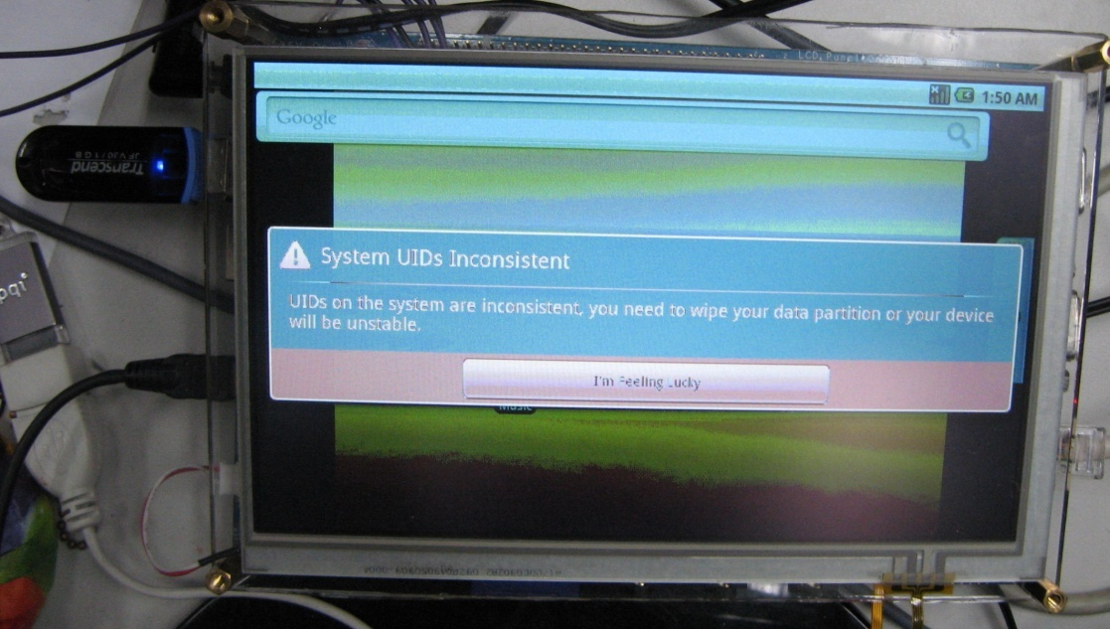
Snapshot

Slide 24
Cont’d
1.Modify format.cpp file:
#vi your_android/system/core/libpixelflinger/format.cpp
-{ 2, 16, {{ 1, 0, 16,11, 11, 6, 6, 1 }}, GGL_RGBA }, // PIXEL_FORMAT_RGBA_5551
+{ 2, 16, {{ 0, 0, 5,0, 10, 5, 15, 10 }}, GGL_RGBA }, // PIXEL_FORMAT_RGBA_0555

Slide 25
Cont’d
2. Modify EGLDisplaySurface.cpp file:
#vi your_andorid/frameworks/base/libs/ui/EGLDisplaySurface.cpp

Slide 26
Cont’d
+395 info.red.offset = 0;
+396 info.red.length = 5;
+397 info.green.offset = 5;
+398 info.green.length = 5;
+399 info.blue.offset = 10;
+400 info.blue.length = 5;
+401 info.transp.offset = 0;
+402 info.transp.length = 0;
+ 520//mFb[i].format = GGL_PIXEL_FORMAT_RGB_565;
- mFb[i].format = GGL_PIXEL_FORMAT_RGB_565;
+ mFb[i].format = GGL_PIXEL_FORMAT_RGBA_5551;

Slide 27
Cont’d
Building Android File System
# make
The file system will in “out/target/product/generic”
When finish these steps. A basic android is already setting up.

Slide 28
Cont’d
5.Download to NT9263 by NFS
We have two reason to recommend you to boot on by NFS , one reason is before we use USB to boot on, we have to check our file system was ok.NFS is easy way to modify if there have something problem. Other reason is android file system is too big (our pattern is only have 64Mbytes so don’t have enough memory to put the file system in)

Slide 29
Cont’d
(a) Install needed packages
# sudo apt-get install tftpd nfs-kernel-server
(b)Modify /etc/exports:
#vi /etc/exports
#/root/android/out/target/product/generic/root 192.168.0.11/32(rw,no_root_squash)

Slide 30
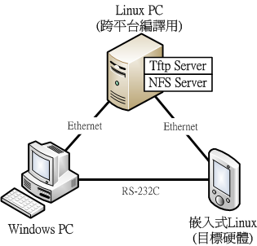
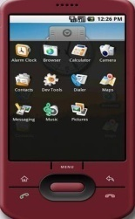
NFS Architecture

Slide 31
Cont’d
The parameters on NFS setting up
192.168.0.11 (target board’s IP)
32 (netmask)
rw (allowed read , write)
no_root_squash (means “root” status)

Slide 32
Cont’d
(c)Set linux server IP:
# sudo ifconfig eth0 192.168.0.10
# sudo /etc/init.d/nfs-kernel-server restart

Slide 33
Cont’d
(d) Modify u-boot’s parameters:
U-Boot>setenv serverip 192.168.0.10
U-Boot>setenv ipaddr 192.168.0.11
U-Boot>setenv bootargs=console=ttyS0,115200 androidboot.console=ttyS0root=/dev/nfs rw init=/init nfsroot=192.168.0.10:/root/android/out/target/product/generic/root ip=192.168.0.11:192.168.0.10:192.168.0.254:255.255.255.0::eth0:off rootwait
U-Boot>saveenv
U-Boot>reset

Slide 34
Cont’d
6. another way is Booting from USB:
After boot android by NFS was work, we canchoose boot android from USB.
Modify u-boot’s parameters
U-Boot>setenv bootargs console=fb0 console=ttyS0,115200 androidboot.console=ttyS0 root=/dev/sda1 rw rootfstype=ext3 init=/init rootdelay=3 rootwait
U-Boot>saveenv
U-Boot>reset

Slide 35
Abstract
Hardware Specification
The Flow of Porting
Other problems in the process
Reference

Slide 36
Other problems in the process
When we want to play media player, we founded there didn’t have voice.
It’s because ALSA default is silent, so we have to
modify a few file.
#vi build/target/board/generic/BoardConfig.mk

Slide 37
Cont’d
6 # The generic product target doesn't have any hardware-specific pieces.
7 TARGET_NO_BOOTLOADER := true
8 TARGET_NO_KERNEL := true
9 TARGET_NO_RADIOIMAGE := true
10 TARGET_CPU_ABI := armeabi
+11 #HAVE_HTC_AUDIO_DRIVER := true
+12 #BOARD_USES_GENERIC_AUDIO := true
+13 BOARD_USES_ALSA_AUDIO := true
+14 BUILD_WITH_ALSA_UTILS := true

Slide 38
Cont’d
# vi system/core/init/devices.c
393 } else if(!strncmp(uevent->subsystem, "mtd", 3)) {
394 base = "/dev/mtd/";
395 mkdir(base, 0755);
+396 } else if(!strncmp(uevent->subsystem, "sound", 5)) {
+397 base = "/dev/snd/";
+398 mkdir(base, 0755);
399 } else if(!strncmp(uevent->subsystem, "misc", 4) &&
400 !strncmp(name, "log_", 4)) {
401 base = "/dev/log/";
402 mkdir(base, 0755);
136 { "/dev/tun", 0640, AID_VPN, AID_VPN, 0 },
+137 { "/dev/snd", 0664, AID_SYSTEM, AID_SYSTEM, 1 },
138 { NULL, 0, 0, 0, 0 },

Slide 39
Cont’d
Download ALSA
# cd .repo
# touch local_manifest.xml
# vi local_manifest.xml
<?xml version="1.0" encoding="UTF-8"?>
<manifest>
<project path="external/alsa-lib" name="platform/external/alsa-lib"/>
<project path="external/alsa-utils" name="platform/external/alsa-utils"/>
<project path="hardware/alsa_sound" name="platform/hardware/alsa_sound"/>
</manifest>
# sync repo

Slide 40
Cont’d
Cancel mute:
# vim hardware/alsa_sound/AudioHardwareALSA.cpp
alsa_amixer set Headphone 100 unmute
alsa_amixer set PCM 100 unmute
alsa_amixer set Master unmute
# vi <android root> init.rc
service alsa_Headphone /system/bin/alsa_amixer set Headphone 100 unmute
service alsa_PCM /system/bin/alsa_amixer set PCM 100 unmute
service alsa_Master /system/bin/alsa_amixer set Master 100 unmute

Slide 41
Cont’d
# vi sound/core/oss/pcm_oss.c
2231 //runtime->oss.rate = 8000;
2232 runtime->oss.rate = 44100;
2235 case SNDRV_MINOR_OSS_PCM_8:
2236 //runtime->oss.format = AFMT_U8;
2237 runtime->oss.format = AFMT_S16_LE;
2245 //runtime->oss.channels = 1;
2246 runtime->oss.channels = 2;
# vi sound/arm/acci.c
1031 //ret = snd_pcm_new(aaci->card, "AACI AC'97", 0, 1, 1, &pcm);
1032 ret = snd_pcm_new(aaci->card, "AACI AC'97", 0, 5, 5, &pcm);

Slide 42
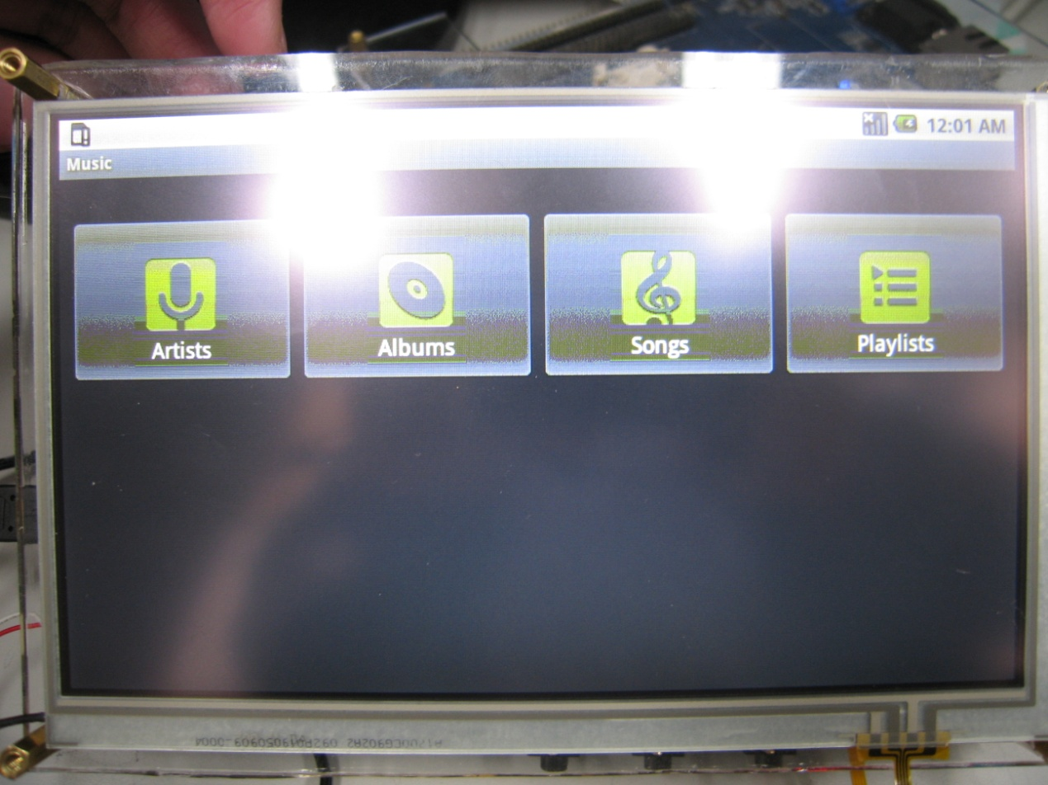
Result

Slide 43
Abstract
Hardware Specification
The Flow of Porting
Other problems in the process
Reference

Slide 44
Reference
website:
http://code.google.com/intl/zh-TW/android/
http://developer.android.com/guide/index.html
paper:
Android 作業系統移植之研究與實現 for pxa270 作者:鍾文昌 指導教授:梁文耀

